Slide 1
Erich W. Vogt:
The Last Lecturer?
An attempt to broker peace between
Lectures & Learning
by
Jess H. Brewer
Vogt Symposium
07 Feb 2015
Notes:
At the CAP congress last June, Alan Poon gave a wonderful talk celebrating Erich’s teaching career. There’s no way I could improve on his testament, so I’m going to try something different: to explain the tension between Erich, who loved lectures and demonstrations, and some advocates of new methods that Physics Education Research has shown to be more effective. Enlightened proponents of both “sides” of this issue have pointed out to me that this is a “straw man” debate, since both lectures and PER-based techniques are essential parts of the instructor’s repertoire. I agree. But not everyone is fully enlightened yet….

Slide 2
OUTLINE
What Erich Said & Did
What Physics Education Research Shows
How to Please [almost] Everyone
Notes:
Okay, here’s what I hope to accomplish in the next 20 minutes. First I’ll give an extremely truncated (per)version of Alan Poon’s talk describing Erich’s teaching.
Then I will give an even more distorted and inadequate summary of what PER has shown about what works and what doesn’t.
And finally I will try to squeeze in a suggestion for how we can eventually have the best of both worlds. (Note: Carl Wieman agreed that this would be a great solution, but that it would be too expensive to implement. Times change.)

Slide 3
Teaching with Erich
Erich & I co-taught 1st Year Honours Physics at UBC in the 1990s; then I “subbed” for him occasionally until he stopped teaching at age 80.
I need not speak for Erich about teaching, inasmuch as you can hear his own words from the interview on the UBC Library “Legacy” site.
Nevertheless I think there are more things he would want to say….
Notes:
I taught First Year Honours Physics with Erich at UBC in the 1990s, sometimes as a team and sometimes “handing off” at Christmas. After that I occasionally filled in for him until he quit teaching at age 80. I think we understood each other pretty well, so I feel qualified to speak for him about teaching. This is unnecessary, of course, inasmuch as you can hear his own words from the interview on the UBC Library “Legacy” site. Nevertheless I think there are a few more things he would want to say….

Slide 4
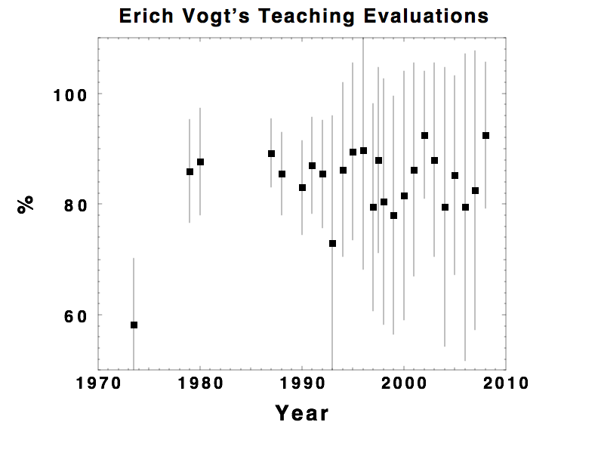
The Obvious:
Overall Effectiveness
Notes:
Everyone has seen this picture or one like it. At UBC the teaching evaluation questions are scored on a 4- or 5-point scale from 1 = bad to 4 or 5 = good; I’ve converted to a percentage scale where the minimum is zero and the maximum is 100, just to make a more familiar vertical axis. This shows that students tended to consider Erich a “first class” instructor. But of course there are other criteria that bear examining….

Slide 5
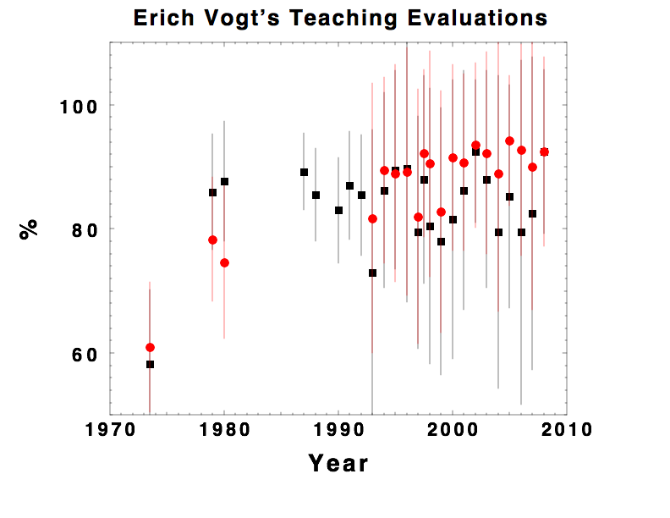
Details:
Stimulating
Overall Effectiveness
Notes:
The black squares on this plot are still the “overall effectiveness” points. Added here are the students’ evaluations of how stimulating (red circles)…

Slide 6
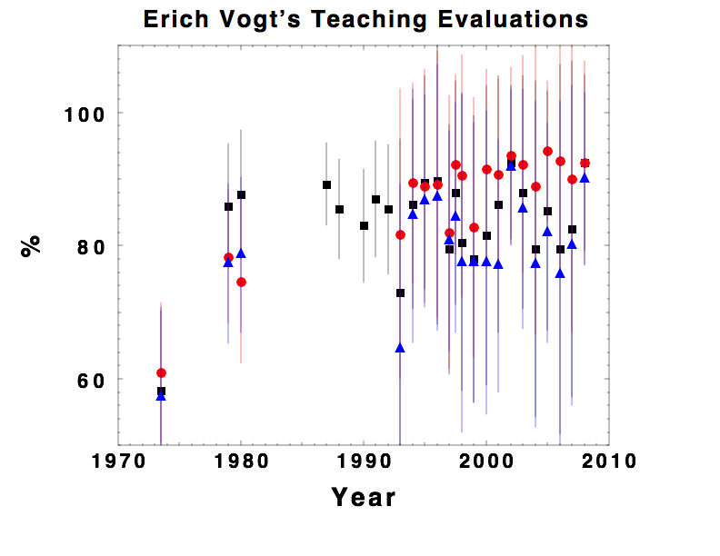
Details:
Stimulating
Overall Effectiveness
Clear
Notes:
…and clear (blue triangles) his presentations were …

Slide 7
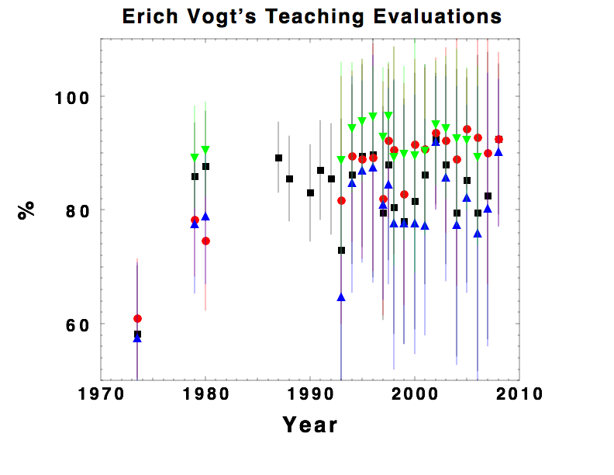
Details:
Receptive
to
Questions
Stimulating
Overall Effectiveness
Clear
Notes:
…and his receptiveness to questions (green nablas). Not surprisingly, his highest scores were on the latter. Although other instructors have received more glowing evaluations occasionally, few if any have had such a consistent record of impressing their students.
What would be much more informative, of course, would be statistics on how Erich’s former students did in their later courses and subsequent careers, compared with those taught by others. Unfortunately, except for anecdotes, this data is unavailable — partly fore lack of examples of UBC students not taught first year Honours Physics by Erich!

Slide 8
Erich generally
Decibels
Happy Birthday | Joyeux anniversaries | Yom Huledet Sameakh | Shēngrì kuàilè | Gelukkige verjaardag | Boldog születésnapot | Buon compleanno | Hauʻoli lā hānau | С днём рождения !
Failure is not an option.
Don’t worry, be happy!
Notes:
Those of us who knew Erich as Director of TRIUMF are well aware of some of his attributes that transferred well to teaching.
First was his speaking voice, which was frequently heard from afar announcing the start of a seminar. I promise you that no student ever begged Erich to “speak up”.
Second was his memory of people. He not only knew the name of every person at TRIUMF, he knew their birthday and how to wish them a happy one in their native language. His pleasure at wishing us all “Gung hay fat choy!” was unmistakeable.
Third was his indefatigability. There is a joke that circulated during the KAON era: Erich met with the Minister in Ottawa, who said, “Let me make this perfectly clear: we will fund KAON when Hell freezes over!” So Erich came home, gathered the troops, and announced, “I have good news and bad news. The good news is that we now have a firm go-ahead commitment from Ottawa. The bad news is that we have a lot of cryogenic work to do.” Although in the end it was not enough that time, Erich got things done by never giving up, and he inspired his students and colleagues alike to have the same attitude.
Finally, what was probably just another facet of the same gem: Anyone who ever went into Erich’s office with a daunting problem always emerged wondering why they thought there was a problem. He was the most effective Pollyanna I have ever known.

Slide 9
Erich on Teaching
Notes:
The following excerpts from the UBC Library’s Legacy interview with Erich pretty much speak for themselves. I have promised not to belabour the overused term “inspiration”, but I can still point out that the engagement we so desire from our students must begin with the instructor, and it must be genuine. Erich’s was.

Slide 10
“Nothing gets the students’ attention as much as if they believe that you know who they are … and that you care.”
Notes:
These excerpts from the UBC Library’s Legacy interview with Erich pretty much speak for themselves. I have promised not to belabour the overused term “inspiration”, but I can still point out that the engagement we so desire from our students must begin with the instructor, and it must be genuine. Erich’s was.

Slide 11
“The main job of the teacher is to get the students so interested in the subject that they go and learn it on their own.”
Notes:
These excerpts from the UBC Library’s Legacy interview with Erich pretty much speak for themselves. I have promised not to belabour the overused term “inspiration”, but I can still point out that the engagement we so desire from our students must begin with the instructor, and it must be genuine. Erich’s was.

Slide 12
Erich on Teaching
“One of the reasons I liked to teach first year was that the students’ eyes still light up when you tell them something new.”
“[Teachers] should focus on their own strengths and use those to get the response from the class that is necessary.” […] “I don’t think there is such a thing as a uniform approach to teaching. You have to work it out for yourself.”
Notes:
These excerpts from the UBC Library’s Legacy interview with Erich pretty much speak for themselves. I have promised not to belabour the overused term “inspiration”, but I can still point out that the engagement we so desire from our students must begin with the instructor, and it must be genuine. Erich’s was.
The second remark above probably revealed Erich’s impatience with what he saw as attempts by Physics Education Researchers to dictate pedagogical methodology to instructors. I think he overreacted to some PER advocates’ evangelical zeal, to everyone’s misfortune. To explain further, I need to describe PER….

Slide 13
What Physics Education Research Shows
Notes:
That last comment of Erich’s revealed his dislike for what I believe he saw as the agenda of PER, namely to impose a “uniform approach to teaching”. I think this was an unfortunate misunderstanding: every collective enterprise includes some overenthusiastic zealots, but most PER advocates understand the importance of good lectures (or so they have said to me). Similarly, although Erich scorned technological aids like “clickers”, he often made good use of simple techniques that PER has found effective.

Slide 14
Excerpts from PER Review (Doktor et al., 2014)
“Synthesis of discipline-based education research in physics”
DOI: 10.1103/PhysRevSTPER.10.020119
(58 pages, 539 references)
“…even when students know the right answers (i.e., when they have supposedly overcome their misconceptions) brain activation [fMRI] suggests that many students may still hold the misconception in memory yet suppress it.”
“Most instructional techniques begin by making students aware of their misconceptions (e.g., by demonstrating to students inconsistencies in their own reasoning across contexts…), and then guiding students through a series of activities or reasoning exercises to reshape their concepts to accommodate scientific concepts.”
“…teaching done in a clear, elegant manner, even [by] charismatic instructors, quite often does not help students overcome misconceptions. […] research showed… that quality of lecturing or instructor charisma had little to do with helping students learn concepts about which they held deeply rooted beliefs that contradicted physical laws.”
Notes:
I should begin by acknowledging that I don’t know what I am talking about. I have read Doktor’s review of Physics Education Research and some of the references, enough to illuminate my ignorance. But I am also left with the impression that I am not alone in this. Therefore I am not hesitant to follow Feynman’s advice (that “Science is the belief in the ignorance of experts!”) and inflict my opinions on you anyway.
Of the myriad tidbits I gleaned from this lengthy but highly condensed tome (and its References), the ones that most impressed me had to do with the proven robustness of incorrect “common sense”…

Slide 15
Interactive Engagement exercise
Assume that your mass is 70 kg.
Within the context of Newtonian Mechanics, approximately what net force do you exert on the Earth?
A: 70 kg. B: Just under 700 N. C. Zero.
Within the context of Newtonian Mechanics, approximately what net force do you exert on the Earth?
Notes:
…so some years ago I devised a little “Interactive Engagement” exercise designed to illustrate this phenomenon. We don’t have “clickers” today, and a “show of hands” is known to produce biased and distorted results, so I won’t ask you to make a visible commitment to one of these answers; just pick the one you think is right, think of why you believe this, and then turn to your neighbour and try to convince him or her of your choice. You have one minute, starting now.
Okay, time’s up. Now I will ask for a show of hands. How many think the correct answer is A? Okay. How about B? And finally, how many pick C? How many changed their minds while talking with their neighbours?
I will declare now that there is only one possible correct answer to this question as stated. Perhaps it will be more evident if I add a little emphasis….
Do we need to discuss this? Did you learn anything? I certainly did when I posed this question first to my students and then to my fellow faculty, in particular those who had taught first year Mechanics! I am happy to report that at least Erich Vogt and Bill Unruh got it right.
Those who are convinced I am wrong are welcome to accost me later. Or you can visit my online tutorial on this topic, under development at http://jick.net/~jess/tut/N3L/

Slide 16
The Feynman Effect
Richard Feynman’s lectures were famously clear, understandable and entertaining. Rapt audiences wondered why the subject was considered hard… until they left the lecture hall. Ten minutes later, their comprehension evaporated and they were left with only the memory of having understood.
PER has confirmed that having concepts explained to you, no matter how cogently, does not implant them into your long-term understanding. For that you must take some initiative, work it out for yourself, or discuss it with others (“interactive engagement”).
Notes:
Richard Feynman’s lectures were famously clear, understandable and entertaining. Rapt audiences understood every explanation and wondered why the subject was considered challenging… until they left the lecture hall. Ten minutes later, all that comprehension had evaporated and they were left with only the memory of having understood. (Which has value in itself!)
PER has confirmed that having concepts explained to you, no matter how clearly, does not implant them into your long-term understanding. For that you must take some initiative, work it out for yourself, or discuss it with others (“interactive engagement”).
The analogy with athletic training is almost perfect: “No pain, no gain!”

Slide 17
IMNSHO
The science of Physics Education Research (PER) reminds me of astronomy before Kepler. A plenitude of tools and expertise have not yet spawned a general explanatory theory.
PER is a crucial discipline, but the current literature seems to encourage a phenomenological, if not reductionist, approach (“Just find out what works best!”) which impoverishes the holistic educational experience.
The memory of having understood (due to a great lecture) can provide the motivation to understand again. With that motivation firmly in place, PER-based techniques can facilitate the learning process.
Notes:
Here’s what I think. PER has not convinced me that Feynman’s (or Vogt’s) lectures served no educational purpose. To their credit, most PER devotees seem to agree. It is not that traditional lectures should be eliminated (what would happen to seminars and conferences?!) but that they should be supplemented by methods that help the students teach themselves.
However, as in all belief systems, some people go overboard and declare other views blasphemous. I have been told that lecturing should be regarded as a form of abuse. It is not. It is one important tool on the educational workbench. Of course, not everyone can do it like Erich! But we should try.

Slide 18
How to Please
[almost]
Everyone
?

Slide 19
https://phet.colorado.edu
Hundreds(?) of “physically correct” simulations 😊
Play and explore without fear of destruction 😊
No need to operate actual lab equipment 😞
Open Source 😄
Notes:
Among the creations of the PER group at Boulder is the collection of Physics Education Technology simulations called “PhET”. These range from simple mechanics demos to illustrations of the production of electromagnetic waves by moving charges, various topics in statistical mechanics and biology. They have proven highly effective in encouraging students to “play and explore” — a very effective learning modality — by virtue of their very virtuality. Unlike most video games, however, the physics is correct.
One downside is that the happy students don’t have to endure the frustration of deciphering the function of actual lab equipment — so they will just have to learn that later….
Best of all, PhET is open source — free to use any way you want.

Slide 20
Excerpt from Koschmann (1996)
“Paradigm Shifts and Instructional Technology”
(Computer-Supported Collaborative Learning)
“If machines can be programmed to display intelligent behavior, there is no reason, at least in principle, that systems could not be designed to assume the role of a skilled teacher. Since one-on-one tutoring is commonly considered the gold standard against which other methods of instruction are measured, the [CSCL] paradigm is founded on the proposition that education could be globally improved by providing every student with a personal (albeit machine-based) tutor.”
Notes:
There is nothing original about this idea,
but the practical tools with which to implement it are imminent.

Slide 21
(“Okay, smartass, what do you suggest?”)
Effective PER methods can be delivered by “expert systems” with infinite patience. (e.g. PhET+CSCL.)
This will free human teachers to “focus on their own strengths” (like giving wonderful lectures).
[Not a] Problem: fewer human teachers may be needed. We will need to educate university administrators, politicians and parents about the proper role(s) of Physics in society.
Notes:
It is generally agreed that a personal tutor who is an expert in the subject being learned is as good as it gets.
Can we provide every student with such a tutor?
YES! Just not a human one.

Slide 22
“The main job of the teacher is to get the students so interested in the subject that they go and learn it on their own.”
Notes:
These excerpts from the UBC Library’s Legacy interview with Erich pretty much speak for themselves. I have promised not to belabour the overused term “inspiration”, but I can still point out that the engagement we so desire from our students must begin with the instructor, and it must be genuine. Erich’s was.

Slide 23
Acknowledgements
Erich, of course, and his UBC Legacy interview
Alan Poon (whose talk on Erich’s teaching is online)
Carl Wieman and the CWSEI team at UBC
PER review by Doktor et al. and its 539 references
Koschmann & other developers of CAI/ITS/CSCL
This talk is at http://jick.net/vogt/Vogt-teacher/
Notes:
All these links are active. If you grab a copy of this talk you can click on them.

Slide 24
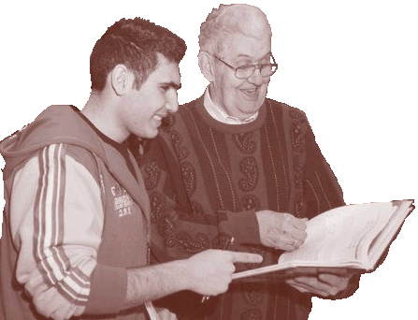
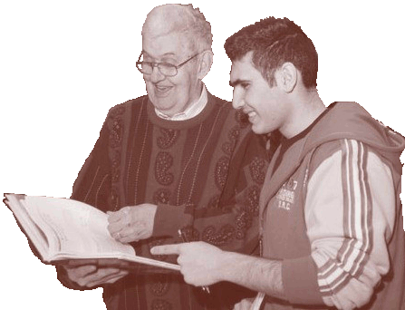
FYSREs
For decades Erich Vogt taught bright, eager 1st Year Physics students who are ineligible for NSERC Undergraduate Student Research Award (USRA) subsidies (only for 2nd & higher years).
The Erich Vogt First Year Student Research Experience (FYSRE) awards offer budding academic stars in 1st Year Physics courses at UBC an opportunity for paid work experience in Physics or Astronomy research at UBC or TRIUMF. Outstanding 1st Year students apply as if for an NSERC USRA. A chosen student's summer salary is shared by the supervisor and the FYSRE grant.
The first FYSRE recipient (Summer 2014) was Walter Wasserman. We now have a batch of excellent applicants for Summer 2015.
More endowment = more FYSREs! Make Your Donation Now!

